Slide 1

Predicting Loss-Making Firms Using Administrative Tax Data

Slide 2

Purpose and Policy Context
Value Proposition:
Enables risk-based targeting in place of blanket audits by developing an automated risk scoring system that:
  Processes firm-level Corporate Income Tax (CIT) return data following the methodology outlined in the project proposal.
  Employs an iterative modeling approach, starting with interpretable logistic regression as a primary benchmark.
  Leverages machine learning techniques to identify high-risk, loss-reporting firms for targeted compliance interventions.
Main Objective: To develop a supervised predictive model that estimates the probability of a firm reporting a loss, as defined in the project proposal.
Business and policy Problem:
Specific Objectives
Empirically identify firm-level characteristics associated with loss reporting in CIT returns.
Develop a supervised predictive model to estimate the probability of a firm reporting a loss.
Assess the concentration and distribution of loss behavior across sectors and firm groups.
Translate firm-level loss probabilities into insights on aggregate CIT revenue risk.
Kenya has persistently failed to meet Corporate Income Tax (CIT) revenue targets. The high prevalence of firms reporting losses significantly erodes the effective tax base, creating fiscal uncertainty
Persistent loss-making firms create compliance risk, inefficient audit allocation and revenue uncertainty.

Slide 3
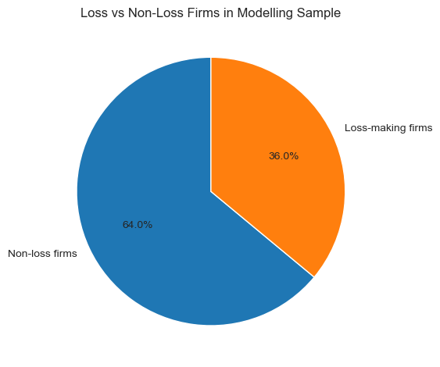
Data understanding and Overview
Data Source:
Class Balance: moderately imbalanced a with approximately 36 loss firms and 64 non-loss firms
The analysis is based on raw 2024 Corporate Income Tax (CIT) return data obtained from administrative tax filings. The dataset contains:
    313,870 firm-year observations
    61 variables
        47 numeric variables (primarily financial statement items)
        14 categorical variables, mainly capturing:
            Sector classification
            Firm size categories
Target Variable Definition
The target variable is defined as:
  is_loss = 1 if Profit Before Tax (PBT) < 0
  is_loss = 0 otherwise
Analytical scope
Retain only firms with positive turnover, which serves as a proxy for active businesses. This excludes dormant or non-operational entities so as to reduce noise and bias the model toward structural losses rather than behavioral or economic risk.

Slide 4
Data Cleaning and Feature Engineering
Data Cleaning
Feature Engineering
Initial Data quality Checks:
This stage translates raw accounting line items into economically meaningful indicators
Quality data checks performed ; with more focus on :
Missing values,
Duplicates
Coercion of mostly-numeric object colums to numeric types.
Numeric sanity checks(Turnover, costs , profit etc)
Design Principles
Feature construction follows four guiding principles:
  Economic interpretability: Features reflect clear business concepts (costs, leverage)
  Scale normalization: Ratios relative to turnover for comparability across firm sizes.
  Leakage avoidance: No features derived from profit/target.
  Noise robustness: Safe divisions and explicit missing-value handling.
Standardization key categorical fields
Sector names standardized
Rare sectors grouped for stability
Core accounting fields aligned:TurnoverProfit before tax,Allowable deductions
High-missing variables tagged (≥60%) and excluded from modelling
Ratio-Based Core Features
construct a set of the following ratios:
  Cost-to-Turnover: Revenue absorbed by direct costs
  Admin Cost Ratio: Overhead intensity
  Employment Cost Ratio: Labour cost pressure
  Financing Cost Ratio: Leverage / debt stress
  Deductions-to-Turnover: Reliance on allowable deductions
Restricting the Modelling Sample
For comparability and validity, restriction of the modelling sample was done to firms that meet all of the following conditions:
  Non-missing gross turnover
  Positive gross turnover (active firms)
  Non-missing profit before tax
This reduces records/ data for modelling to 99491
Class imbalance is maintained for sample.

Slide 5
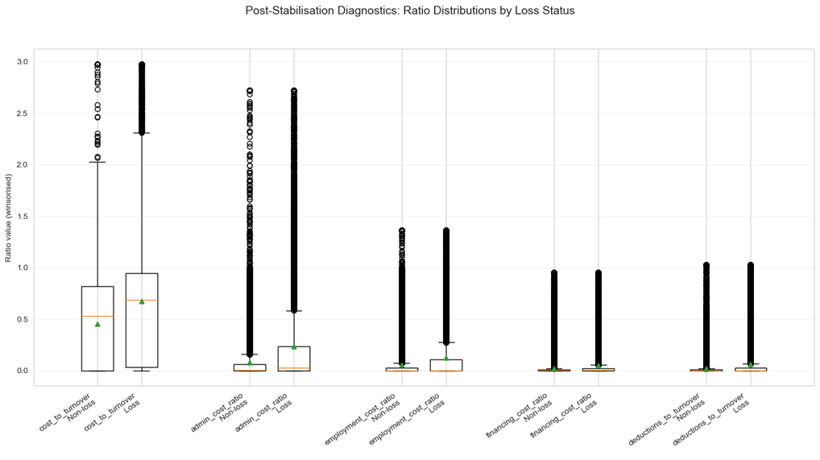
Data Cleaning and Feature Engineering
Feature Engineering…cont.
Binary Indicators for Threshold Effects
As loss risk is often non-linear, firms near cost saturation behave differently from those with healthy margins. The following binary indicators were used:
  High-Cost Flag: Cost-to-turnover > 90% → extreme cost pressure
  Thin-Margin Flag: Margin 95–105% → near break-even, vulnerable to shocks
Turnover Stratification
Firms are also grouped into turnover quartiles:Q1 (smallest firms) → Q4 (largest firms) so as to capture scale effects and identify whether loss incidence is concentrated among smaller or larger firms and to support policy-relevant segmentation
Outlier Handling
The graph above shows that:
  Stabilization procedure worked as intended,
  Outliers have been effectively trimmed.
  Distributions are reasonable and interpretable.
  Structural differences between loss and non-loss firms are apparent.
  Additionally, data is frozen so at ensures that all subsequent modelling, reporting, and performance comparison uses exactly the same input data, eliminating accidental variation or cherry-picking.
Uncontrolled outliers can dominate model estimation, leading to unstable and misleading results.
Each ratio feature is winsorised at the 1st and 99th Percentiles where the extreme low and high values are capped.

Slide 6
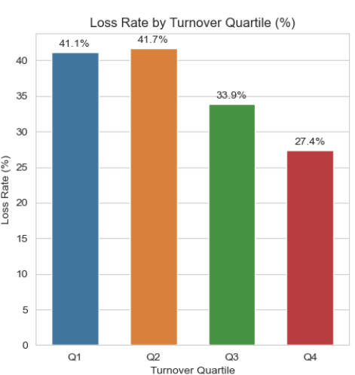
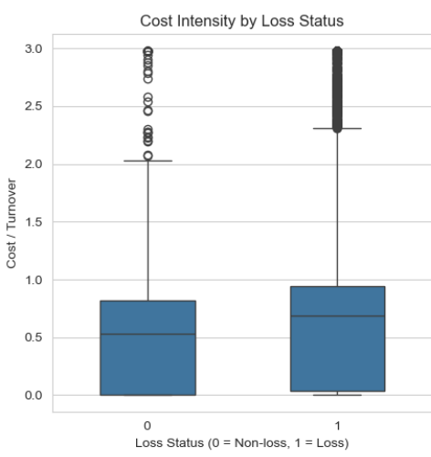
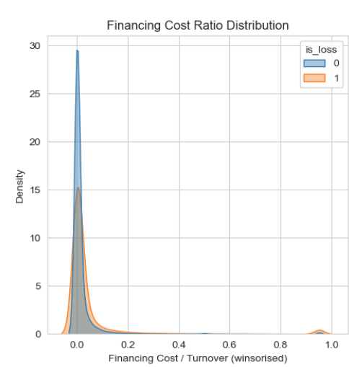
Exploratory Data Analysis – Key Patterns
EDA shows strong and intuitive separation between loss and non‑loss firms:
Firm size:
Loss rates exceed 40% in the bottom turnover quartiles
Decline steadily with size, but remain material even among large firms
Cost intensity:
Dominant differentiator
Loss firms show higher medians and heavy right tails indicating structural cost pressure
Financing costs:
Right‑skewed among loss firms, suggesting leverage and financing structure effects

Slide 7
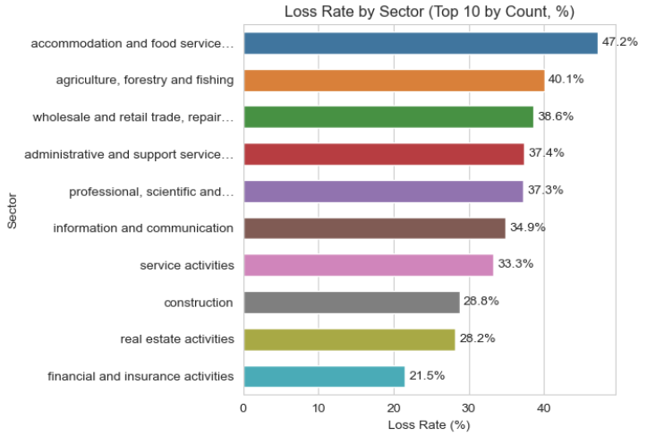
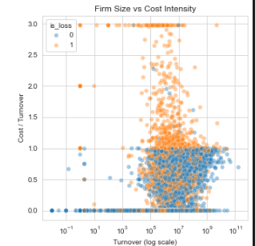
Exploratory Data Analysis – Key Patterns
Sectoral concentration:
Losses are concentrated in certain sectors:
  Accommodation and food services
  Agriculture
  Wholesale and retail trade
  Administrative services
Conversely, financial and insurance sectors show lower loss rates
Firm Size vs Cost Intensity
Confirms a non-linear relationship:
Even large firms with elevated cost intensity are likely to report losses
Justifies models capable of capturing non-linear effects and interactions

Slide 8
Data Preparation and Preprocessing Summary
Modelling Strategy
Sample and Feature summary
Got a baseline and progressed to richer models:
  Logistic Regression- Baseline
  Random Forest
  Gradient Boosting
  XGBoost
Identical preprocessing across all models:
Median imputation (numeric) and Modal imputation + one-hot encoding (categorical)
Final dataset (post-cleaning and feature engineering):
99,332 firm observations
Split into:
  Training set: 74,499 observations
  Test set: 24,833 observations
Explanatory features: 289: Which includes engineered ratios, structural flags, and one-hot encoded categorical controls.
Test set loss rate = 36%. This indicates moderate class imbalance, motivating metrics beyond simple accuracy such as ROC–AUC, Precision–Recall)
Basic Model Results – Interpreting Loss Drivers
Primary drivers of losses:
  Cost structure
  Financing intensity
Sector and size are conditioning factors, not root causes
Policy focus:
  Support cost efficiency improvements
  Ease financing constraints
  Target small and manufacturing firms for compliance monitoring,
  risk assessment, or targeted support

Slide 9
Models results and comparison
Model | ROC–AUC | PR–AUC | Key Takeaway
Logistic Regression (Baseline) | 0.7386 | 0.6593 | Interpretable benchmark; shows losses are driven by cost structure, size, and sector, but limited in capturing nonlinear effects.
Random Forest | 0.7899 | 0.7252 | Strong improvement over linear models; better recall of loss firms but lower precision and weaker calibration.
HistGradientBoosting | 0.798 | 0.750 | Confirms boosting is well suited; efficient and accurate, but limited control and interpretability.
XGBoost (Fast-tuned) | 0.8535 | 0.8167 | Best overall discrimination; flexible regularisation and strong precision for high-risk firms.
Optimised XGBoost (Early-Stopping) | 0.8509 | 0.8131 | Best calibrated and most stable model; preferred for operational, risk-based compliance profiling.
Key Insights:
XGBoost: provides highest discrimination and precision, ideal for targeted risk profiling
Random Forest : higher recall, lower precision → better for broad coverage but less targeting efficiency
Logistic Regression: linear specification underperforms, limited for complex nonlinear patterns

Slide 10
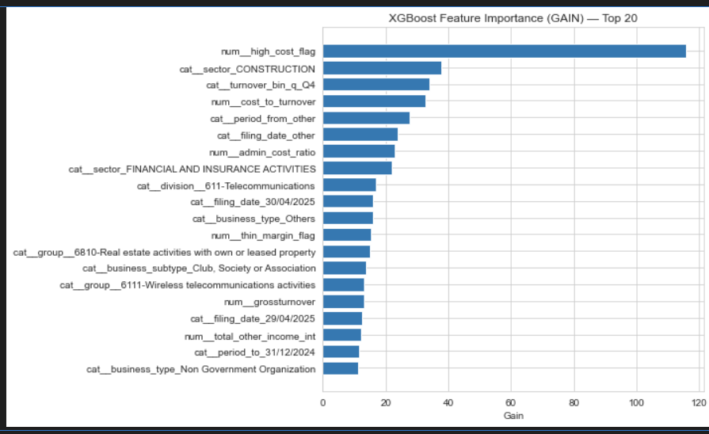
Feature Importance
Feature Importance (GAIN):
Measures average improvement in the objective function due to splits on each feature
Top drivers:
  Cost-to-turnover ratio – strongest predictor, highlights centrality of cost pressure
  Sectoral indicators – Construction, Financial/Insurance, Manufacturing
  Firm size quartiles – especially largest firms (Q4)
  High-cost / thin-margin flags – viability threshold indicators
  Financing and deduction intensity – leverage and tax adjustments
XGBoost captures nonlinear interactions between costs, size, and sector more effectively than linear/logistic models, while maintaining economic interpretability.

